Slide 1
Final Review
CST 334

Slide 2
For each C file in the current directory print the filename and copy the file to the parent directory.
for f in *.c; do
echo $f;
cp $f ../$f;
done

Slide 3
Write a BNF grammar that creates “a”, “(a)”, “((a))”...
expr ::= a | ( expr )

Slide 4
Write a BNF grammar that creates only “1 + 1” and “1 + x”.
expr ::= 1 + expr1
expr1 ::= 1 | x

Slide 5
Rewrite to eliminate left recursion. Assume var is a terminal value.
expr ::= expr + expr | var
expr ::= var expr1
expr1 ::= + var expr1 | “”

Slide 6
A grammar is __________ if, for some string that can be derived from the grammar, there is more than one parse tree.
ambiguous

Slide 7
Create a parse tree for “1 * 3 + 5”.
expr ::= num | expr + expr | expr * expr
expr
expr
*
expr
num
expr
+
expr
1
num
num
3
5

Slide 8
__________________ uses a special hardware device that transfers data between devices and memory without CPU help.
Direct Memory Access (DMA)

Slide 9
If a disk spins at 5400 RPM what is the average rotational delay?
min 60 sec. 1000 ms
ms
rev
*
*
=
=
11.1
5400 rev min sec
ms
rev
ms
rev
11.1
=
/
2
5.55

Slide 10
Given: access time is 10 ms, transfer rate is 50 MB/s
How long will it take to do 200 random reads of 32 KB each?
hint: 200 * (access time + transfer time)
transfer time:
1 s 1 MB 1000 ms. 32 KB
50 MB. 1000 KB 1 s
*
*
*
=
.64 ms
200 * (10 ms + .64ms) = 2128ms = 2.1 s

Slide 11
Given: access time is 10 ms, transfer rate is 100 MB/s
How long will it take to do a sequential read of 2.4 MB?
transfer time:
1 s 1000 ms 2.4 MB
100 MB 1 s
*
*
=
24 ms
10 ms + 24 ms = 34 ms

Slide 12
Initial state
inode bitmap 100000
inodes [d a:0 r:2] [] [] [] [] []
data bitmap 100000
data [(.,0)(..,0)] [] [] [] [] []
inode bitmap 110000
inodes [d a:0 r:3] [d a:1 r:2] [] [] [] []
data bitmap 110000
data [(.,0) (..,0) (c,1)] [(.,1) (..,0)] [] [] [] []
Possible operations: mkdir(), creat(), open(), write(), close(), link(), unlink()
mkdir(“/c”)
Which operation took place?

Slide 13
inode bitmap 110000
inodes [d a:0 r:3] [d a:1 r:2] [] [] [] []
data bitmap 110000
data [(.,0) (..,0) (c,1)] [(.,1) (..,0)] [] [] [] []
Initial state
inode bitmap 111000
inodes [d a:0 r:3] [d a:1 r:3] [f a:-1 r:1] [] [] []
data bitmap 110000
data [(.,0) (..,0) (c,1)] [(.,1) (..,0) (t,2)] [] [] [] []
Possible operations: mkdir(), creat(), open(), write(), close(), link(), unlink()
creat(“/c/t”)
Which operation took place?

Slide 14
When multiple threads are running, and the output depends on the timing of their execution, then the code has a ___________.
race condition

Slide 15
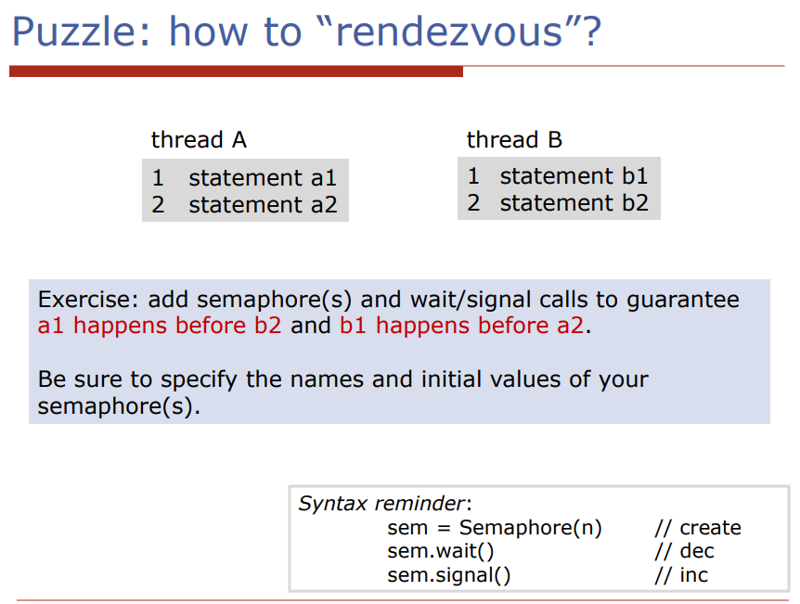

Slide 16
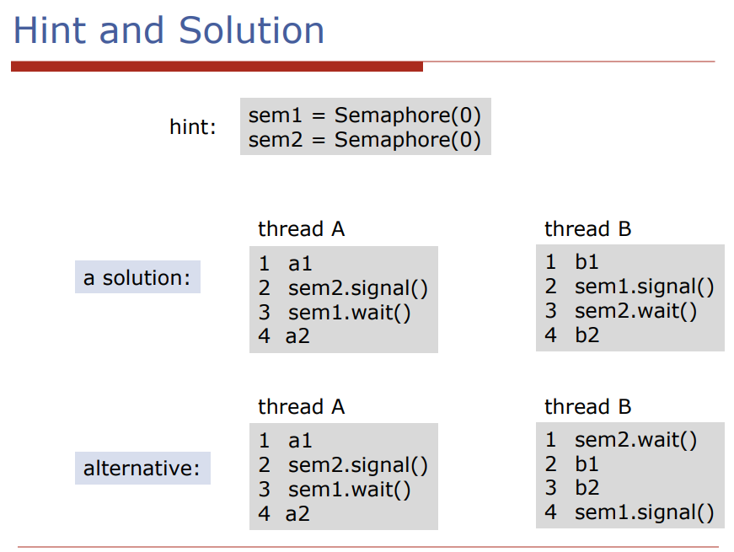

Slide 17
Append the first 5 lines of foo.txt to the file temp.txt.
head -5 foo.txt >> temp.txt

Slide 18
Change the file foo.txt to give the owner read, write, and execute permissions, give the group and others read permissions.
chmod 744 foo.txt

Slide 19
Given: a = 5, b = 5, c = 12
Assume: all jobs arrive at the same time
What is the average turnaround time using Round Robin Scheduling?
What is the average turnaround time using Shortest Job First? What is the average response time?
17.3
avg turnaround time = 12.3
avg response time = 5

Slide 20
Assume the 5th column of the file foo.txt is a positive number greater than zero. Using awk find and print the max value in column 5 of foo.txt.
awk ‘{if ($5 > max) max = $5 } END { print max}’

Slide 21
A ___________ is a piece of code that accesses a shared resource, such as a shared variable.
critical section

Slide 22
What is the blocking operation in the pthreads api?
pthread_cond_wait

Slide 23
If a fork call returns a value of 0 which process is it?
child process

Slide 24
List all the files in the current directory, sort them, and output the results to the file foo.txt
ls | sort > foo.txt

Slide 25
Uncompress the file ‘msh.tar.gz’
gunzip msh.tar.gz

Slide 26
Expand the archive file ‘hw1.tar’ in your current working directory
tar xf hw1.tar

